Slide 1
Homework 1 (Due: 3/4)
繳交組員名單
Homework 2 (Due: 3/11)
Input a color image C(R,G,B)
Output the color image C
3. Transform the color image C into a
grayscale image I by I = (R+G+B)/3
4. Show the grayscale image I.
Homework 3 (Due: 3/18)
每組繳交一份報告用PPT檔

Slide 2

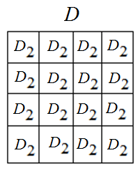
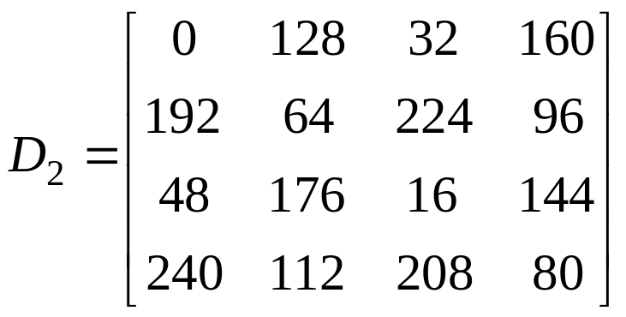
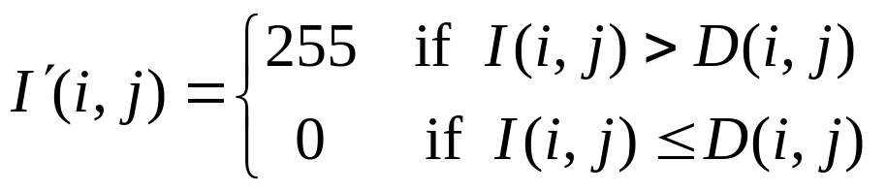

Homework 4 (Due: 3/25)
(A) Given a grayscale image I,
Step 1: Use the dithering matrix to generate an
array D of image size by repeating
Step 2: Threshold image I by
Step 3: Show images I and
3-<number>

Slide 3

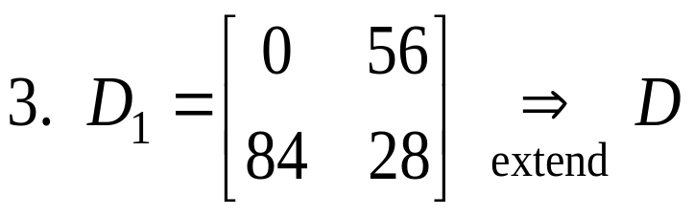
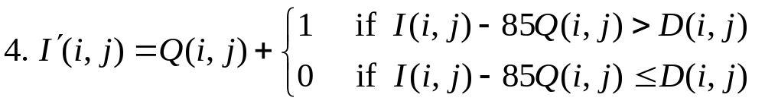

(B) Extend to n = 4 gray values
1. 255 / 3 = 85
5. Scale values of so that its values are in
[0, 255] for displaying
3-<number>

Slide 4
Homework 5 (Due: 4/8)
Develop a histogram equalization (HE) program;
Apply the HE to i) gray, ii) color images;
3. For each input image, print out the input/output images and their histograms.
4. Discuss your experiments.
For a color image C,
(i) Convert it into a gray image G;
(ii) Apply HE to G to get G’;
(iii) For each pixel of C, modify its color (r,g,b)
by (r’,g’,b’) = (r,g,b) X G’ / G.

Slide 5
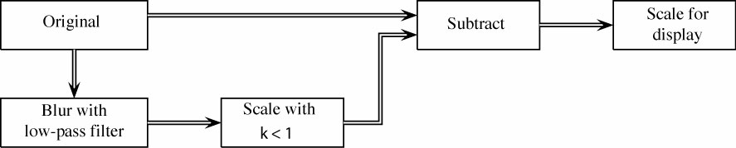
Homework 6 (Due: 4/15)
1. Select an experimental image
2. Apply a 3 by 3 (a) average filter and (b) median
filter to the image
3. Unsharp masking

Slide 6

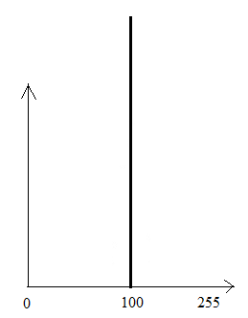
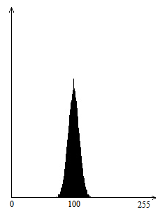


Homework 7 (Due: 4/29)
(1) Create an image g(x,y) whose pixels all have the same gray
value of 100. Show the image g(x,y).
(2) Generate Gaussian noise n(x,y), with , using
the algorithm shown in the next page.
Show the noisy image f(x,y) = g(x,y) + n(x,y).
(3) Display the histogram h(i) of f(x,y).
(4) Comment on your results.
Example:
Input image g(x,y) of gray values of 100
Histogram
of g(x,y)
Noisy image
f(x,y)
Histogram
of f(x,y)

Slide 7
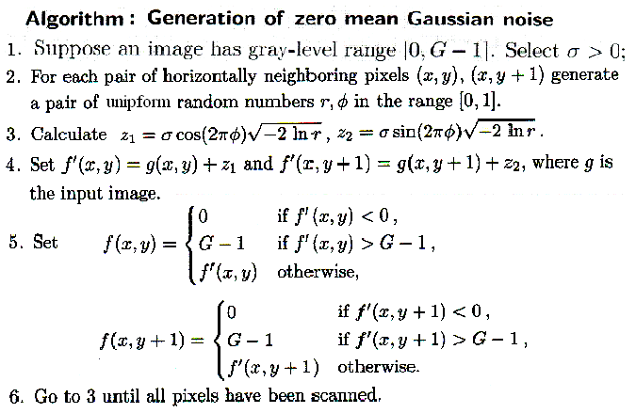
2-<number>

Slide 8
Homework 8 (Due: 5/6)
Implement Otsu’s thresholding method

Slide 9
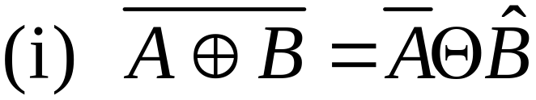

Homework 9 (Due: 5/13)
Prove
Options:

Slide 10
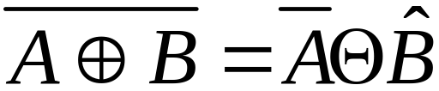
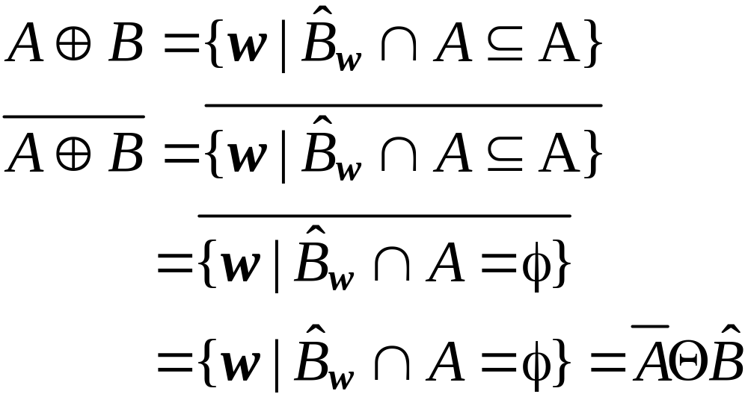
Show (i)

Slide 11

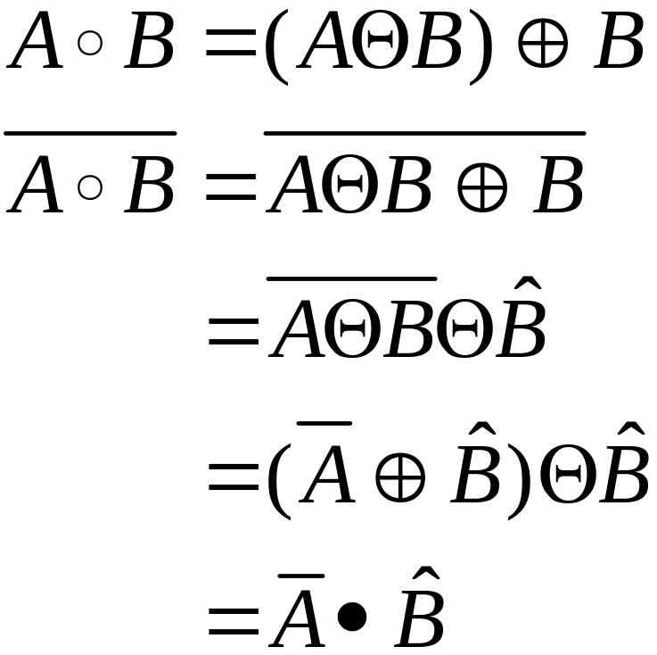
(ii)

Slide 12
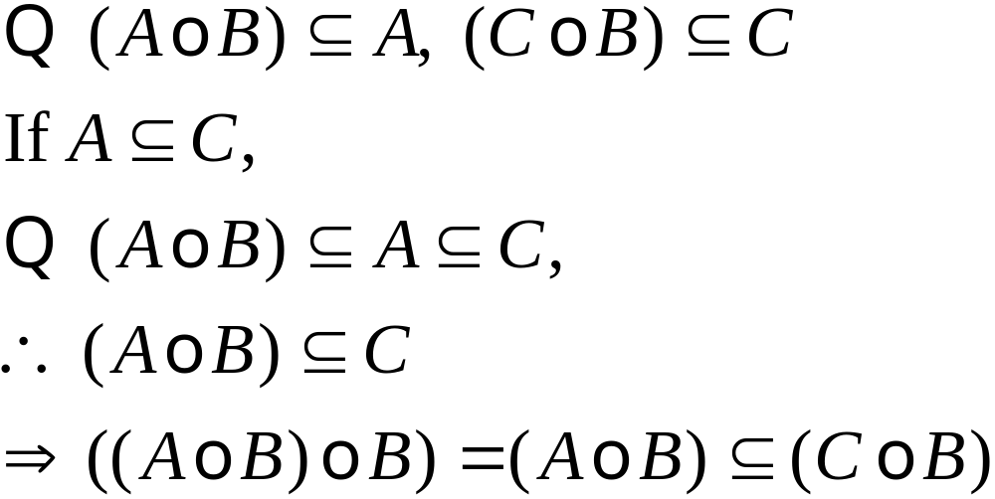
Options (a):
Homework 3 (Due: 3/18)
每組繳交一份報告用PPT檔

Slide 13
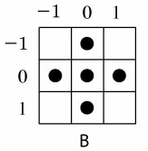



Homework 10 (Due: 5/20)
Implement the Lantuejoul’s skeletonization method
using the structuring element B:
Apply the method to the following input image
Input image
Experimental results

Slide 14
Homework 11 (Due: 5/27)
每組繳交一份報告用PPT檔

Slide 15






Homework 12 (Due:6/3 )
Perform contrast enhancements for a color image.
(1) Input a RGB color image;
(2) Scale its RGB pixel values to rgb values,
where
(3) Transfer rgb pixel values into hsi values;
(4) Apply the histogram equalization algorithm to
the i component to obtain the component;
(5) Transfer the values into values;
(6) Scale values to values,
where
(7) Output the RGB and color images.

